Slide 1
Checking and securing dividing a fraction by a whole number
Arithmetic procedures with fractions

Slide 2
how to use Oak lessons

Slide 3
I can use the mathematical structures that underpin the division of fractions to divide a fraction by a whole number.

Slide 4
The lowest common multiple (LCM) is the lowest number that is a multiple of two or more numbers.
Example
The LCM of 3 and 4 is 12
The LCM of 4 and 10 is 20

Slide 5

Checking and securing dividing a fraction by a whole number
Contexts for dividing fractions
Dividing any fraction by a whole number

Slide 6
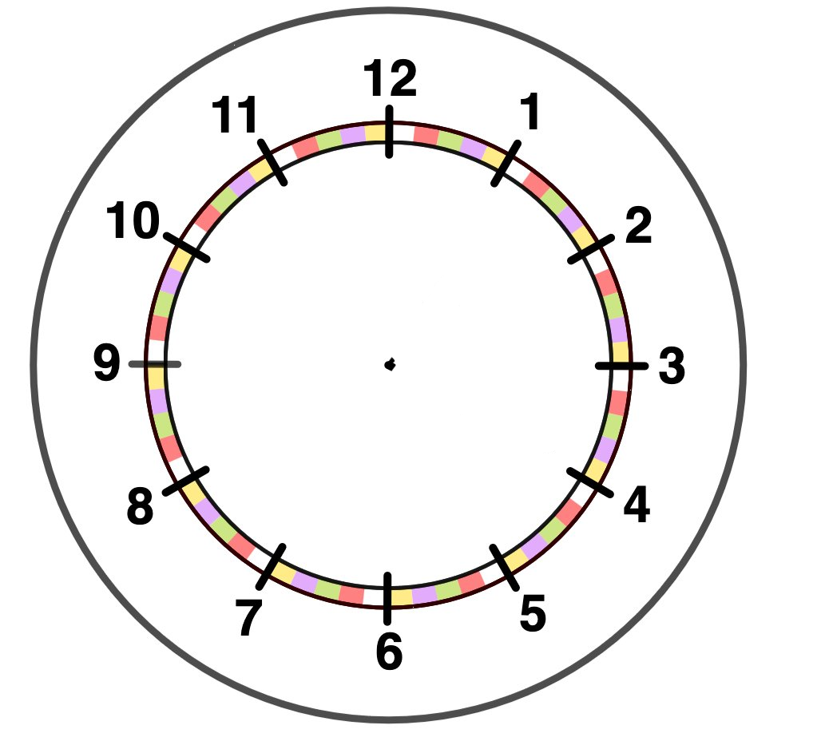
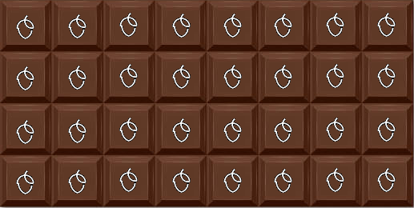

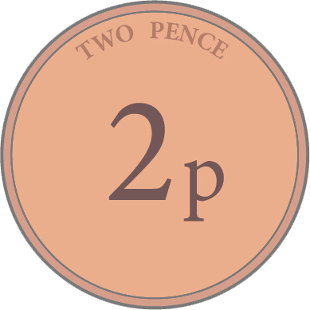
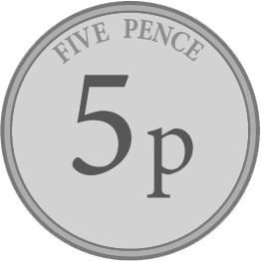
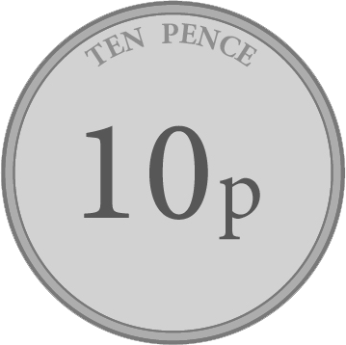


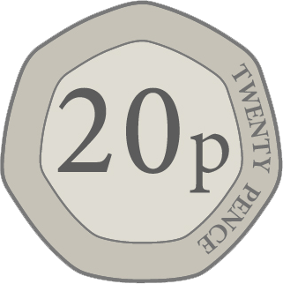
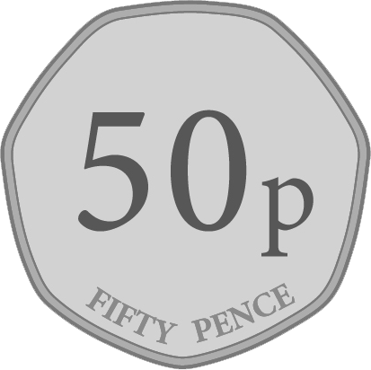
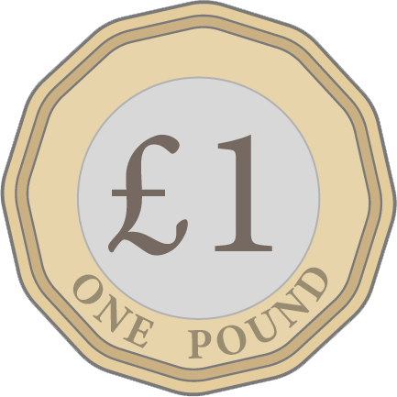
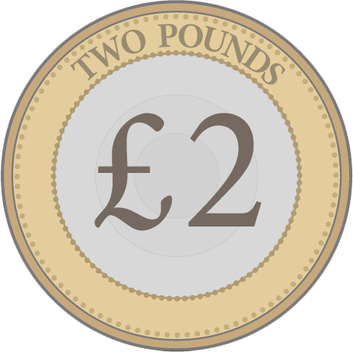
Contexts for dividing fractions
We use fractions in everyday life as fractions are useful when dividing quantities, such as money, time or food.
Example
Example
Example
Sometimes, we are not even aware we are using fractions and division when we are given everyday life questions.

Slide 7
Contexts for dividing fractions
Here is a chocolate bar. The chocolate bar has 16 equal pieces.
An Oak teacher has a chocolate bar takes one piece and shares the rest equally among five students.
The Oak teacher takes one piece.
How many pieces will she give to each of her five students?

Slide 8

Contexts for dividing fractions
There are now 15 pieces left for the students, so each student gets three pieces.
What fraction does each student receive from the whole chocolate bar?
The Oak teacher takes one piece.

Slide 9
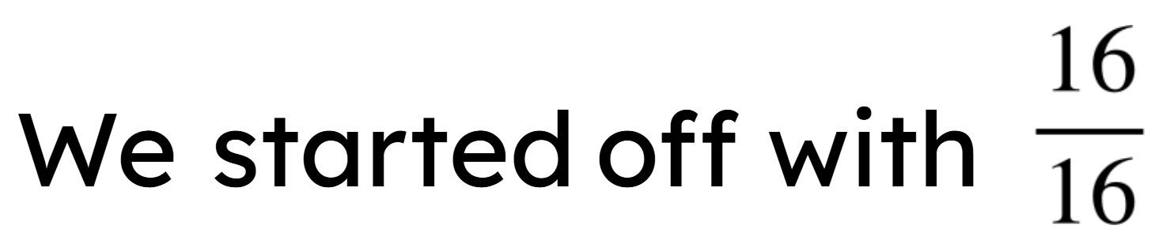
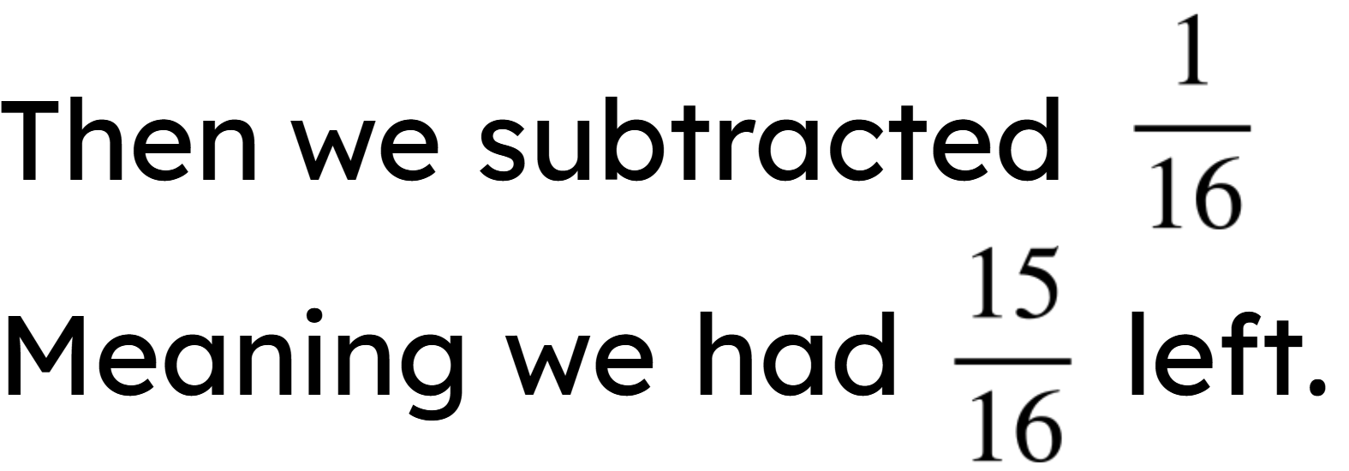
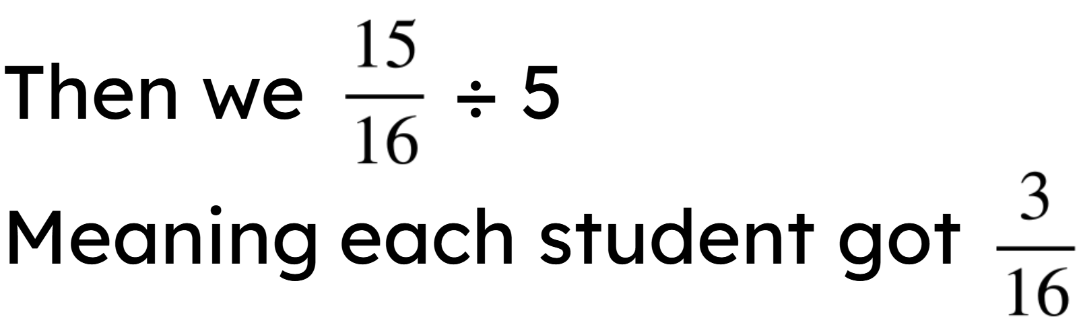
Contexts for dividing fractions
Summarising,

Slide 10
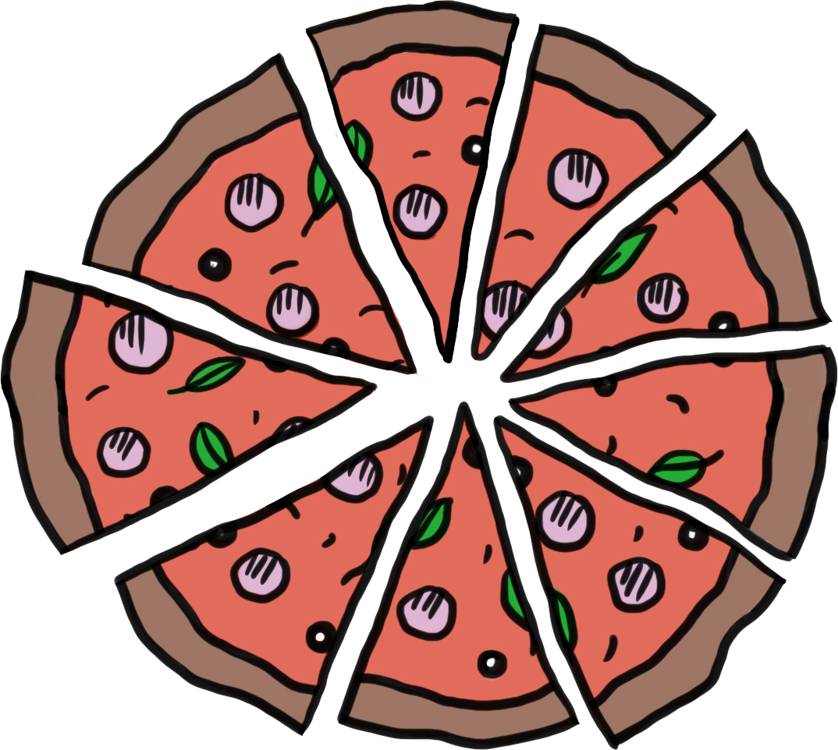

Contexts for dividing fractions
A pizza is divided into nine equal pieces.
The Oak teacher takes one piece and shares the rest equally between four students.
What fraction does each student receive from the whole pizza?
Each student gets
of the pizza.

Slide 11



Contexts for dividing fractions
A pizza is divided into 3 equal pieces. An Oak teacher takes 1 piece and the remaining pieces will be equally divided amongst 3 students.
The 2 pieces is not an easy number to divide by 3.
However, splitting 2 pieces into 6 pieces, makes it easier.

Slide 12
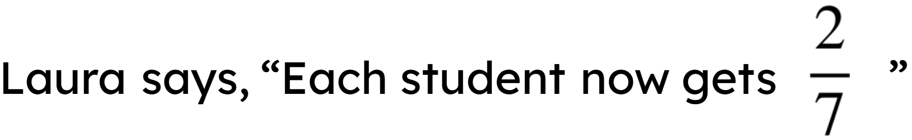
Contexts for dividing fractions
A pizza is divided into 3 equal pieces. An Oak teacher takes 1 piece and the remaining pieces will be equally divided amongst 3 students.
Is she correct? Explain
She is incorrect. The whole
pizza needs to be divided
equally, so this means each
student
got
.

Slide 13
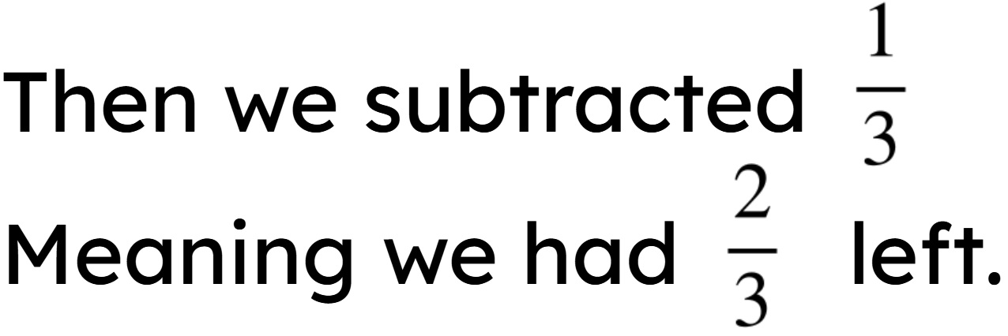
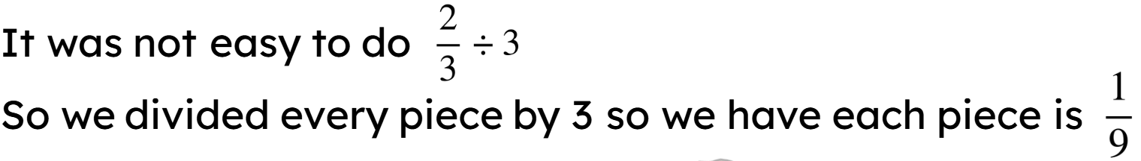
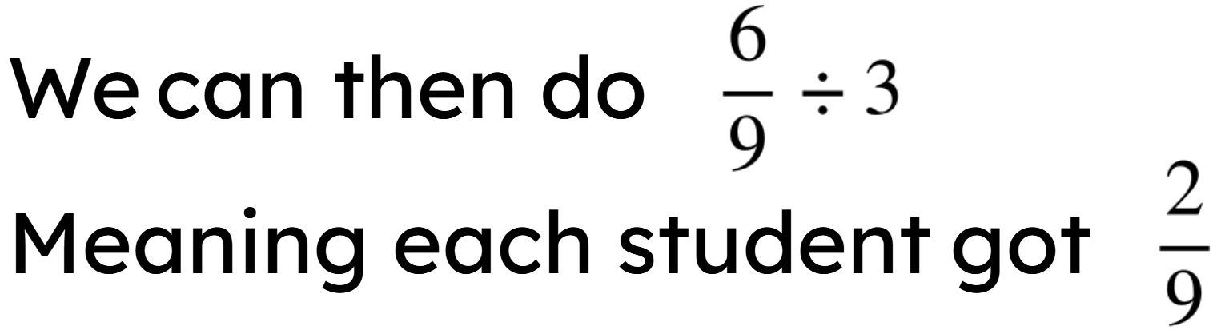
Contexts for dividing fractions
Summarising,
we started off with a whole pizza divided equally by 3

Slide 14


Contexts for dividing fractions
1) A pizza is split into 12 equal pieces. A teacher takes 2 pieces and the remaining is given equally between 2 students. What fraction of the whole pizza does each student receive?
2) There are 14 crayons in a box. Two are lost and the rest are shared equally between a table of 4 students. What fraction of the full crayon box does each student receive?

Slide 15

Contexts for dividing fractions
3) A chocolate bar has 24 equal pieces. The teacher eats 6 pieces and shares the rest between 3 students. The teacher says everyone has had the same fraction of the chocolate bar. Is the teacher correct?
4) A pizza is cut into 4 equal pieces. There are 6 people who need to share the pizza equally.
How should the pizza be cut so everyone receives an equal piece? What fraction does each person receive?

Slide 16

Contexts for dividing fractions
A pizza is split into 12 equal pieces. A teacher takes 2 pieces and the remaining is given equally between 2 students. What fraction of the whole pizza does each student receive?
Removing 2 pieces means there are 10 pieces left.
Dividing these 10 pieces by 2 means each person gets 5 pieces each.
This means each person receives

Slide 17

Contexts for dividing fractions
2) There are 14 crayons in a box. Two are lost and the rest are shared equally between a table of 4 students. What fraction of the full crayon box does each student receive?
Removing 2 crayons means there are 12 left.
Dividing these 12 pieces by 4 means each person gets 3.
This means each person receives

Slide 18

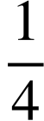
Contexts for dividing fractions
3) A chocolate bar has 24 equal pieces. The teacher eats 6 pieces and shares the rest between 3 students. The teacher says everyone has had the same fraction of the chocolate bar. Is the teacher correct?
Removing 6 pieces means there are 18 pieces left.
Dividing these 18 pieces by 3 means each person gets 6.
This means that they all received the same fraction, or of the chocolate bar.

Slide 19

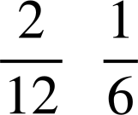
Contexts for dividing fractions
4) A pizza is cut into 4 equal pieces. There are 6 people who need to share the pizza equally.
How should the pizza be cut so everyone receives an equal piece? What fraction does each person receive?
Cut each ¼ into 3 pieces.
This means there are 12 pieces.
Each person then gets
Which is the same as

Slide 20
Checking and securing dividing a fraction by a whole number
Contexts for dividing fractions
Dividing any fraction by a whole number

Slide 21
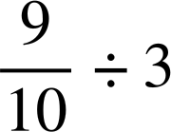

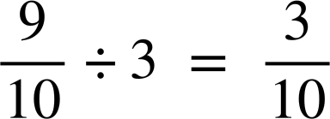
Dividing any fraction by a whole number
Let’s use bar models to show a quicker and more efficient way to do divide fractions by whole numbers.
For example,
Here is the 1
1
does
the
What
look like?
the
be divided
Can
into 3 equal groups?

Slide 22
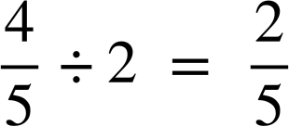
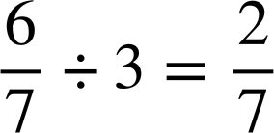




Dividing any fraction by a whole number
Using bar models, show the working out for
Using bar models, show the working out for
1
1

Slide 23
Dividing any fraction by a whole number
Can you see an easier way to divide the fraction by the integer without bar models?
1
1
When the numerator of the dividend is a multiple of the divisor, the division of the fraction by the integer can be quickly worked out.

Slide 24
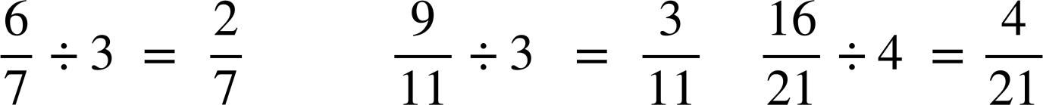
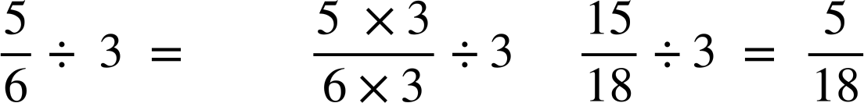
Dividing any fraction by a whole number
When the numerator of the fraction is a multiple of the divisor, the division of the fraction by the integer can be quickly worked out.
For example,
In this next one, you need to divide 5 parts into 3 groups.
The numerator of the fraction is not a multiple of the divisor.

Slide 25


Dividing any fraction by a whole number
For example,
1
Here is 1
What does
look like?

Slide 26
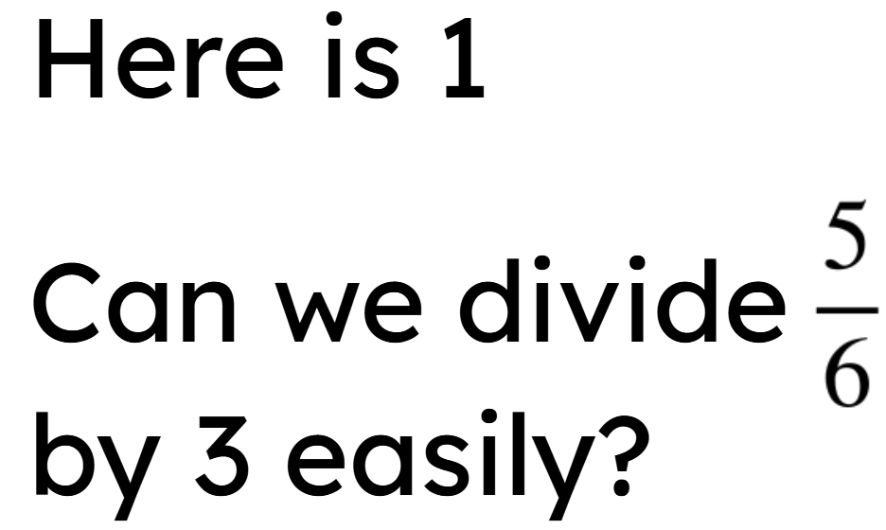
Dividing any fraction by a whole number
For
example,
1
This cannot be divided into 3 easily

Slide 27


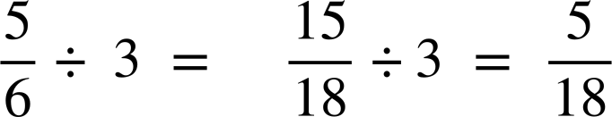
Dividing any fraction by a whole number
For
example,
1
Let’s divide each
by 3
Can
be
divided by 3?

Slide 28

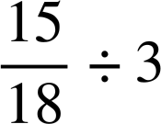
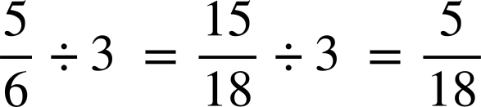
Dividing any fraction by a whole number
Summarising,
We could not divide the
by 3 easily
So
we
divided
each
by
3
to
give
So
we
could
see

Slide 29
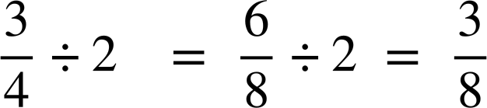

Dividing any fraction by a whole number
Work out the missing numbers
We
1
could
not
divide
the
by 2 easily.
So
we
divided
each
by
2
to give
So
we
could
see

Slide 30
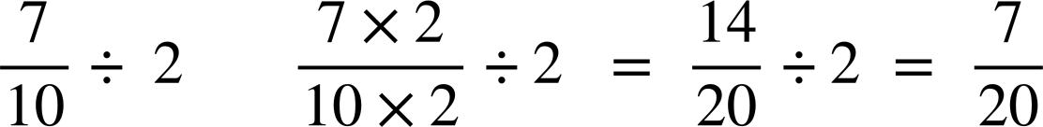

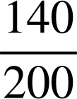
Dividing any fraction by a whole number
Removing the bar models and using equivalent fractions can make the calculation easier.
For
example,
Which equivalent fraction should be used for
to make the division easier?
or
or
Writing an equivalent fraction where the numerator of the dividend is a multiple of the divisor makes the calculation easier.

Slide 31
Dividing any fraction by a whole number
14 is the LCM of 7 and 2
For example,
Using the LCM of the numerator of the dividend and the divisor means you can divide more efficiently.

Slide 32
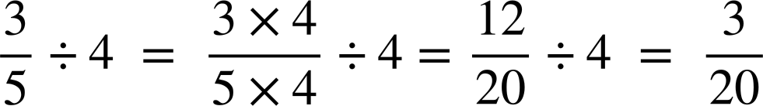
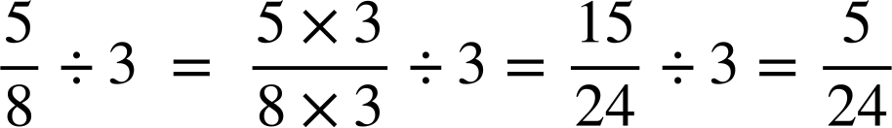
Dividing any fraction by a whole number
Work out the answer to
Show all your working out.
Work out the answer to
Show all your working out.
12 is the LCM of 3 and 4
15 is the LCM of 5 and 3

Slide 33
Dividing any fraction by a whole number
Match the questions and answers.

Slide 34
Dividing any fraction by a whole number
2) Work out the answers to the following. You can draw bar models if needed.
a)
b)
c)
d)

Slide 35

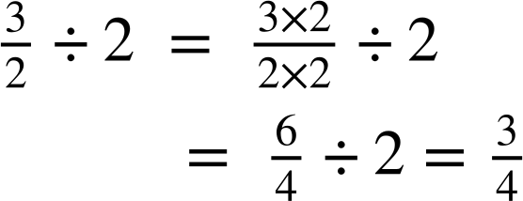
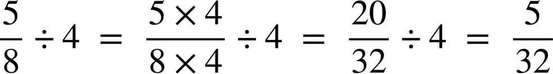
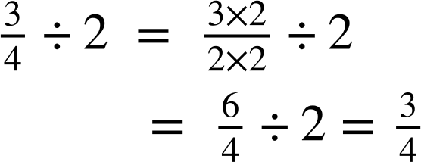
Dividing any fraction by a whole number
3) Jacob has used equivalent fractions to work out his answer but has spilt ink all over his work. Can you identify what his missing numbers were?
a)
b)

Slide 36
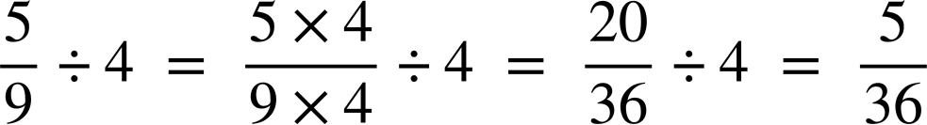
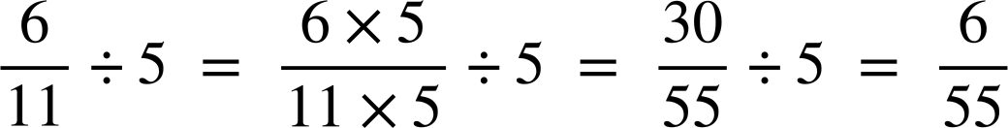
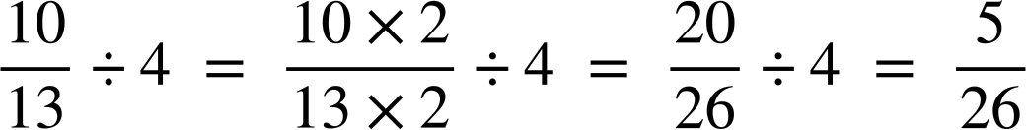
Dividing any fraction by a whole number
4) Work out the answers to the following, giving your answer in its simplest form.
a)
b)
c)

Slide 37
Dividing any fraction by a whole number
Match the questions and answers.

Slide 38
Dividing any fraction by a whole number
2) Work out the answers to the following. You can draw bar models if needed.
a)
b)
c)
d)

Slide 39
Dividing any fraction by a whole number
3) Jacob has used equivalent fractions to work out his answer but has spilt ink all over his work. Can you identify what his missing numbers were?
a)
b)

Slide 40
Dividing any fraction by a whole number
4) Work out the answers to the following, giving your answer in its simplest form.
a)
b)
c)

Slide 41
Checking and securing dividing a fraction by a whole number
We use fractions in everyday life as fractions are useful when dividing quantities, such as money, time or food.
Sometimes we can divide a fraction by an integer by simply looking at the numerator of the dividend.
Sometimes we need to use an equivalent fraction to divide the fraction by an integer and make the calculation easier.

Slide 42

© Oak National Academy 2023.
Produced in partnership with Mathematics in Education and Industry.
Licensed on the Open Government Licence v3.0, except where otherwise stated. See Oak terms and conditions.

